Slide 1
Global Warming

Slide 2
Evidence for rapid climate change
Global temperature rise
The planet's average surface temperature has risen about 1.1 degrees Celsius since the late 19th century
16 of the 17 warmest years on record occurring since 2001.
2016 the warmest year on record

Slide 3


Slide 4
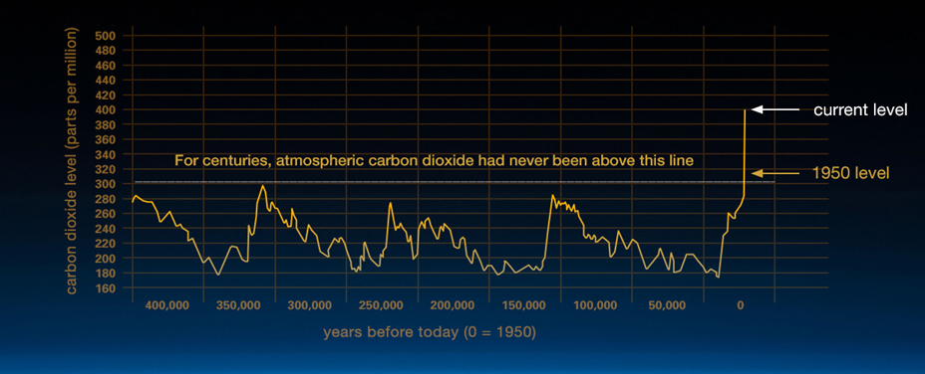
Climate change: How do we know?

Slide 5
Warming Oceans
The oceans have absorbed much of this increased heat, with the top 700 meters (about 2,300 feet) of ocean showing warming of 0.302 degrees Fahrenheit since 1969.

Slide 6
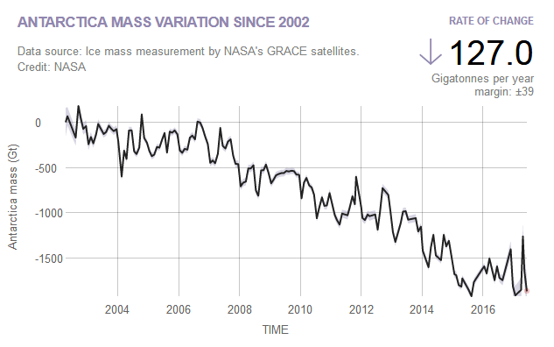
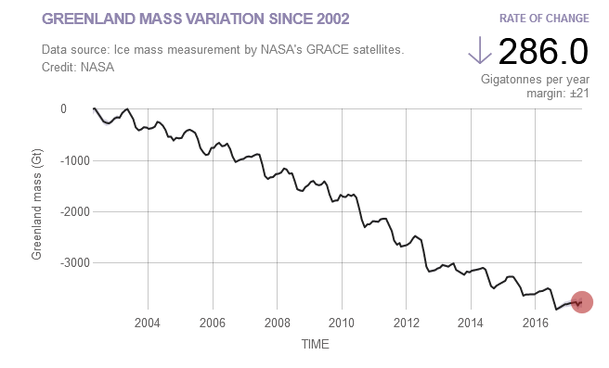
Shrinking ice sheets

Slide 7
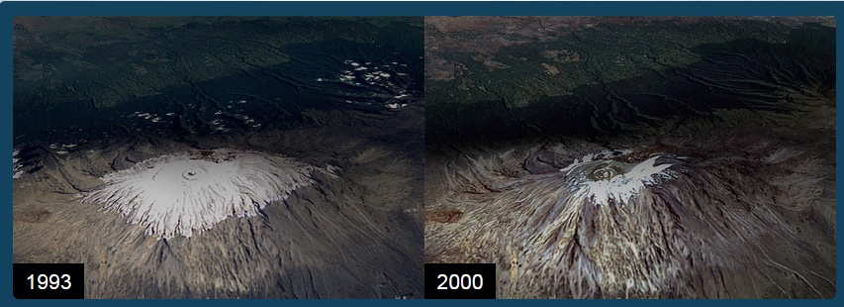
Glacial Retreat
Glaciers are retreating almost everywhere around the world — including in the Alps, Himalayas, Andes, Rockies, Alaska and Africa
Kilimanjaro Glacier

Slide 8
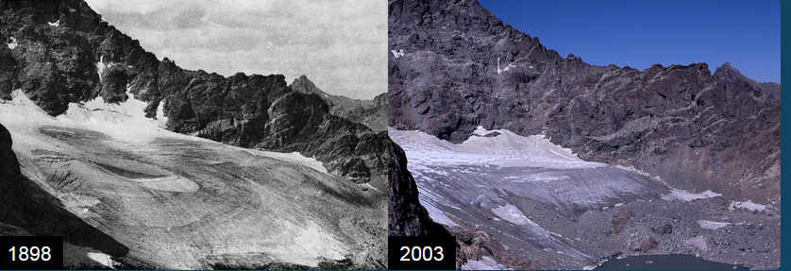
Rocky Mountains

Slide 9
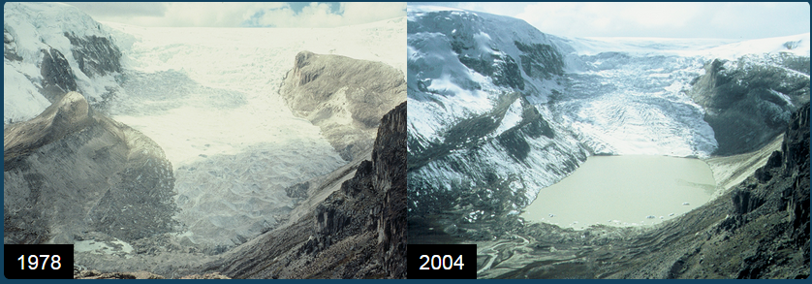
Andes

Slide 10
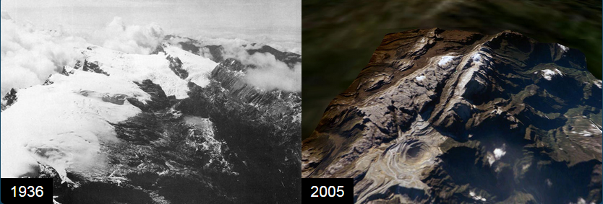
Sudirman Range

Slide 11
Decreased snow cover
Satellite observations reveal that the amount of spring snow cover in the Northern Hemisphere has decreased over the past five decades and that the snow is melting earlier.

Slide 12
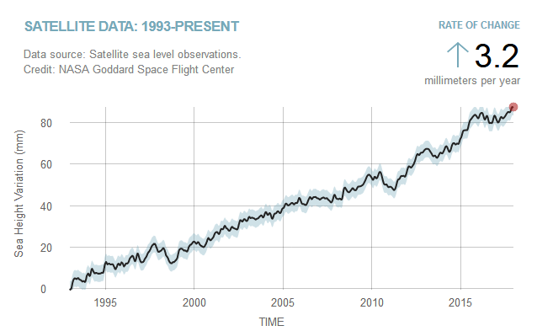
Sea level rise
Global sea level rose about 8 inches in the last century. The rate in the last two decades, however, is nearly double that of the last century.

Slide 13
Quiz
Sea level has remained fairly constant throughout Earth's history. Y/N ?
Over long geological timescales, changes in the shape of the ocean basins and in land/sea distribution affect sea level. During the past few million years' ice age cycles, sea level has varied by more than a hundred meters.

Slide 14
2
Melting sea ice has the potential to raise sea level by several meters Y/N?
Melting sea ice cannot raise global sea level since the ice is already floating. (Think of an ice cube melting in a glass full of water.) However, Arctic sea ice is thinning and the long-term summer average has decreased by 34 percent since 1979. Ice from glaciers and ice sheets, which form on land, does add water to Earth's ocean when it melts and does contribute to sea level rise

Slide 15
3
Other than melting land-based ice sheets, which of these factors has made the largest contribution to the rise in sea level over the past 100 years?
A. Warming of ocean surface waters
B. Melting sea ice
C. Increased river runoff
As the ocean warms, it expands and sea level rises, accounting for about a third of the approximately 20-centimeter sea level rise seen in the past century. Water released by melting land-based ice sheets contributes the other two-thirds of sea level rise.

Slide 16
4
What percentage of heat from global warming has the ocean absorbed in the past 40 years?
11 percent B. 35 percent C. 93 percent
C,Water resists changes in temperature; it is slow to heat up and slow to cool down. In scientific terms, water has high heat capacity. This means that, so far, Earth's ocean has been able to absorb and hold a majority of the heat from Earth's atmosphere.

Slide 17
5
The normal temperature range for ocean surface water is:
2 to 40°C
-2 to 35°C
5 to 50°C
4.5 to 18°C
-2 to 35°C
Very cold and very salty water sinks to become deep water in Earth's polar regions, while warm water tends to remain on the surface in tropical waters. Fresh water freezes at 0°C, but sea water freezes at colder temperatures because it contains salt.

Slide 18
6
What percentage of the world's population lives within 100 kilometers of the shoreline?
39 percent B. 60 percent C. 70 percent
39 percent
According to the World Resources Institute, in 1995 2.2 billion people, or 39 percent of the world's population, lived on or within 100 kilometers of a seashore. Recent studies reveal that up to 600 million people live in Low Elevation Coastal Zones and 200 million people live within coastal flood plains.

Slide 19
7
Sea level rise contributes to more frequent flooding in which of these coastal areas?
Venice, Italy B. Tuvalu C. Bangladesh D. All of the above
Tuvalu, a small island nation in the Pacific Ocean, is only 4.5 meters above sea level at its highest point. Rising sea level and high tides could submerge it entirely. Bangladesh is affected by yearly monsoonal flooding in addition to sea level rise. Venice becomes inundated because the land is gradually sinking by about 10 centimeters per year, an effect exacerbated by sea level rise.

Slide 20
What’s the difference between climate change and global warming?
Global warming” refers to the long-term warming of the planet
“Climate change” encompasses global warming, but refers to the broader range of changes that are happening to our planet. These include rising sea levels, shrinking mountain glaciers, accelerating ice melt in Greenland, Antarctica and the Arctic, and shifts in flower/plant blooming times. These are all consequences of the warming

Slide 21
Is the sun causing global warming?

Slide 22
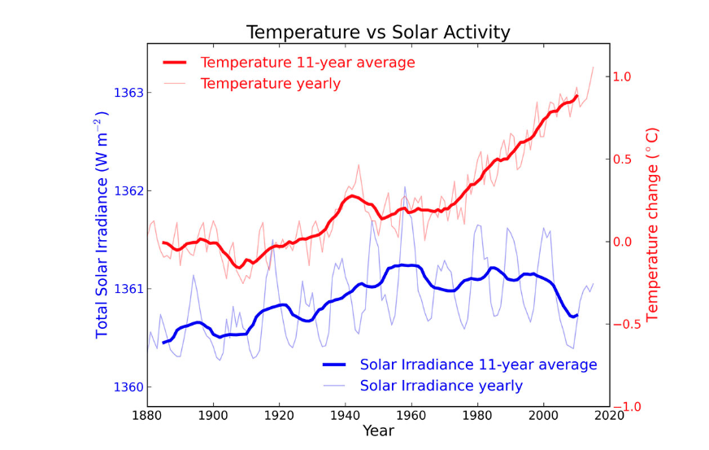

Slide 23
Is the ozone hole causing climate change?

Slide 24
Is the ozone hole causing climate change?
Sun’s UV rays slip through the ozone hole, their net effect is to cool the stratosphere more than they warm the troposphere
ozone hole has been affecting climate in the Southern Hemisphere
The colder stratosphere has resulted in faster winds near the pole, which somewhat surprisingly can have impacts all the way to the equator, affecting tropical circulation and rainfall at lower latitudes.
The ozone hole is not causing global warming, but it is affecting atmospheric circulation.

Slide 25
If we immediately stopped emitting greenhouses gases, would global warming stop?

Slide 26
Not right away.
The Earth’s surface temperature does not react instantaneously to the energy imbalance created by rising carbon dioxide levels.
Even if all emissions were to stop today, the Earth’s average surface temperature would climb another 0.6 degrees or so over the next several decades before temperatures stopped rising

Slide 27
Is it too late to prevent climate change?

Slide 28
Is it too late to prevent climate change?
It may not be too late to avoid or limit some of the worst effects of climate change.
Responding to climate change will involve a two-tier approach,
1) “mitigation” – reducing the flow of greenhouse gases into the atmosphere
2) “adaptation” – learning to live with and adapt to the climate change that has already been set in motion.

